Slide 1

AI Agents
Gabriel Chan

Slide 2
Agenda
Definition
Components
Working Terminologies
Multi-agent platforms
Use-case explanation
Proof of Concept Demo
Learnings
Temperature
Prompting
Future Developments
References

Slide 3
Definition
AI agents are artificial intelligence that use tools to accomplish goals. AI agents have the ability to remember across tasks and changing states; they can use one or more AI models to complete tasks; and they can decide when to access internal or external systems on a user’s behalf. This enables AI agents to make decisions and take actions autonomously with minimal human oversight.

Slide 4
Components
1) Agent-centric interfaces, including the protocols and APIs used to connect agents to users, databases, sensors, and other systems, allowing intelligent software agents to observe their environment.
2) Memory module:
short-term memory for recent events and immediate context
long-term memory for factual knowledge, concepts, details of past conversations, and knowledge of how past tasks were performed.
3) Profile module:
agent’s attributes
Role
Goals
behavioral patterns
4) Planning module:
uses an LLM or SLM
takes observations from the environment, including memory and the agent’s profile, to assemble appropriate plans for an agent to take.
5) Action module:
the APIs and system integrations that define the universe of actions available to the AI agent.

Slide 5
Agent Attributes in Crew AI
Attribute | Description
Role | Agent function and expertise
Goal | Guides decision making of the agent
Backstory | Provides more context and personality for the agent to enrich interactions
LLM | Language model that powers the agent
Tools | Capabilities or functions available for agent to use(Defaults to empty list)

Slide 6
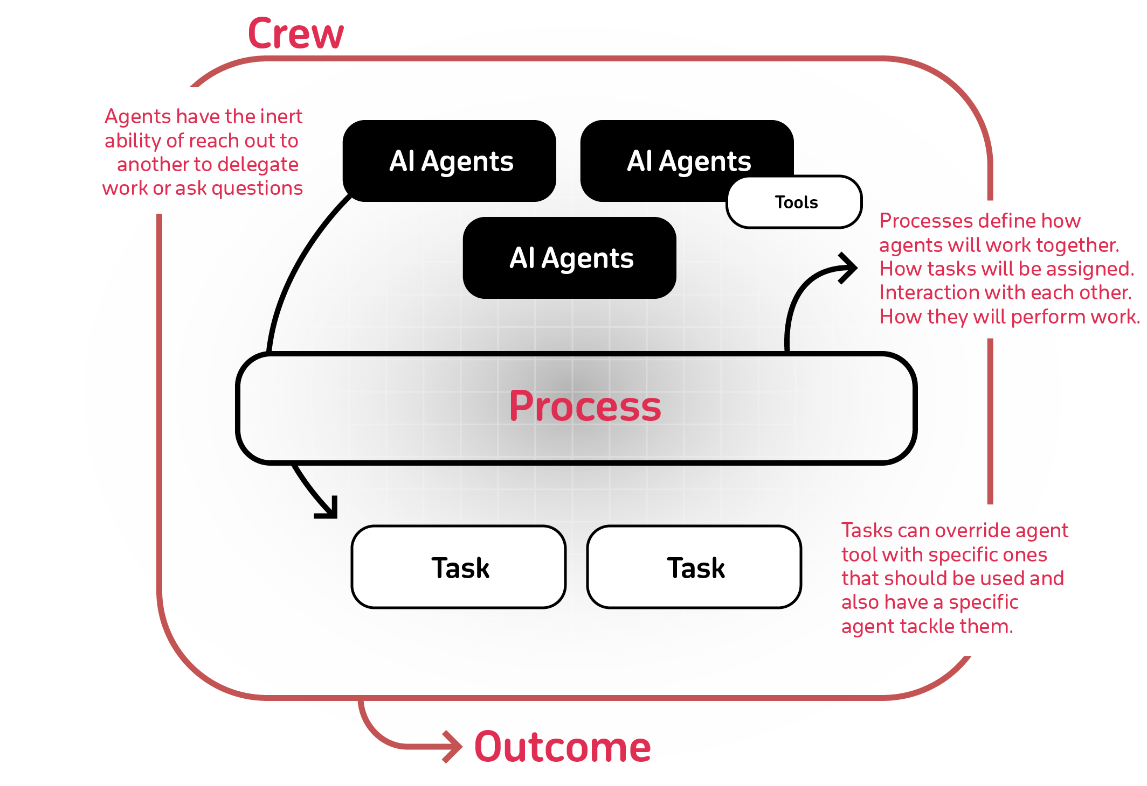
Multi-Agent Platform in Crew AI
Component | Description | Key Features
Crew | The top-level organization | • Manages AI agent teams • Oversees workflows • Ensures collaboration • Delivers outcomes
AI Agents | Specialized team members | • Have specific roles (researcher, writer) • Use designated tools • Can delegate tasks • Make autonomous decisions
Process | Workflow management system | • Defines collaboration patterns • Controls task assignments • Manages interactions • Ensures efficient execution
Tasks | Individual assignments | • Have clear objectives • Use specific tools • Feed into larger process • Produce actionable results
Notes:
https://docs.crewai.com/introduction
How It All Works Together
The Crew organizes the overall operation
AI Agents work on their specialized tasks
The Process ensures smooth collaboration
Tasks get completed to achieve the goal

Slide 7




Use-case

Slide 8


Proof of Concept Demo

Slide 9
Learnings - Temperature
Temperature: parameter that controls the “creativity” or randomness of text
Use Case | Temperature | Description
Code Generation | 0.2 | Generates code that adheres to established patterns and conventions. Output is more deterministic and focused. Useful for generating syntactically correct code.
Creative Writing | 0.7 | Generates creative and diverse text for storytelling. Output is more exploratory and less constrained by patterns.
Chatbot Responses | 0.5 | Generates conversational responses that balance coherence and diversity. Output is more natural and engaging.
Notes:
https://community.openai.com/t/cheat-sheet-mastering-temperature-and-top-p-in-chatgpt-api/172683

Slide 10
Learning - Prompting
- Ensuring that the agent role, goal and backstory are align and specific to what the outcome is wanted from the agent
Would amount this to job description seen on linkedin or indeed on what you would expect for a certain role
The task descriptions need to be very specific
There is difficulty in maintaining consistency in agent builds, this can be mitigated to a point using proper prompting templates.

Slide 11
Future Development Ideas
Growing this crew to also look at other types of files such as excel, text, powerpoints
SQL Agent - developing sql queries or sql translations
RAG search on confluence/jira
Data discovery when linked to databases or hadoop
SQL retrival/visualization on data lineage
workflow searches with chatbot when linked to github to link templates or similar technologies to prevent building workflows from scratch

Slide 12
References
https://www.bcg.com/capabilities/artificial-intelligence/ai-agents
https://docs.crewai.com/concepts/agents
https://community.openai.com/t/cheat-sheet-mastering-temperature-and-top-p-in-chatgpt-api/172683

